Slide 1
Developing Regression Models
Train and Tune Regression Models
Evaluate Regression Models

Slide 2

Train and Tune Regression Models

Slide 3






You Are Here (Process, Analyze, Train Models)
Frame the Problem
Identify & Collect Data
Process Data
Analyze Data
Finalize the Project
Train Models

Slide 4
Linear Regression
50
Dependent Variable
0
0
100
Independent Variable

Slide 5

Linear Equation
$$y=mx+b$$
Linear equation—Describes a straight line in terms of x and y points within the line, the slope of the line, and the location where the line intercepts the y-axis when x is 0.
Where:
y is the y-value for a data example (the dependent variable).
x is the x-value for a data example (the independent variable).
m is the slope of the line, calculated by dividing the change in y by the change in x.
b is the intercept—the value of y when x is 0.
Provides a basis for understanding linear regression.
Generates a straight line to fit linear data.
Foundational concept in statistics.

Slide 6
Linear Equation Example Data
Months Since First Release | Sale Price in Dollars
0 | 849.99
8 | 819.49
19 | 775.99
30 | 699.49
37 | 720.49
44 | 745.99
56 | 625.99
66 | 560.99
75 | 580.49
87 | 520.99
92 | 590.49
99 | 440.99
105 | 389.99
112 | 405.99
120 | 299.99
900
Sale Price ($)
200
0
120
Months Since Release

Slide 7

Straight Line Fit to Example Data (Slide 1 of 2)
$$y=−4.144x+864.3$$
900
Sale Price ($)
200
0
120
Months Since Release

Slide 8
Straight Line Fit to Example Data (Slide 2 of 2)
$$y=\left(−4.144\right)60+864.3=615.66$$
900
Predicted value
Sale Price ($)
200
0
120
Months Since Release

Slide 9
Linear Equation Shortcomings
Linear equation:
Provides a simple approach to making estimations based on a dataset.
Is not as powerful as other ways of applying linear regression to machine learning.
May not work well or as expected with data that cannot be fit linearly.
Fails to account for multiple predictors.
Market lifespan is not the only factor that influences how much a TV sells for. Other factors include the display resolution, screen size, units sold, R&D cost, manufacturing cost, and many more.
Machine learning tasks often necessitate somewhat more complex approaches to linear regression.

Slide 10


Linear Regression in Machine Learning
Linear regression—Provides a basic linear model in machine learning.
Where:
ŷ is the variable you're trying to estimate (the dependent variable).
θ₀ is the intercept (equivalent to b in the linear equation).
θ₁ is a model parameter (equivalent to m in the linear equation).
x is the independent variable of interest—the features you'd extract and pass into the model.
$$\hat{y}=θ_{0}+θ_{1}∙x$$
Linear regression algorithm finds error/cost.
Difference between input training data and estimative line fit that the model generates.
Each feature will have a parameter $θ_{i}$that the model must solve for.
What model "learns," just like in logistic regression.

Slide 11
Linear Regression in Machine Learning Example
TV price example:
Start by mapping a single feature, the TV's market lifespan, plugged into the formula as:
When you map this function to more features, you can evaluate the fit to a straight line.
If data fits to the line, that feature has a strong correlation with the prediction variable.
Linear regression is commonly used in supervised learning to estimate numerical values (the dependent variables) that increase or decrease based on multiple features (the independent variables).
$$TV_price=θ_{0}+θ_{1}∙time_on_market$$

Slide 12




Matrices in Linear Regression
Single-parameter linear model equation—Represents linear equations for each value of x and y in a dataset.
$$\left[\begin{matrix}y_{1} \\ ⋮ \\ y_{n}\end{matrix}\right]=\left[\begin{matrix}1 & x_{1} \\ ⋮ & ⋮ \\ 1 & x_{n}\end{matrix}\right]\left[\begin{matrix}θ_{0} \\ θ_{1}\end{matrix}\right]$$
For simplicity's sake, consider how these matrices would be filled in using just the last two points of the TV price dataset: (112, 405.99) and (120, 299.99).
After applying the inverse matrix:
After plugging in the last two points of the dataset:
$$\left[\begin{matrix}405.99 \\ 299.99\end{matrix}\right]=\left[\begin{matrix}1 & 112 \\ 1 & 120\end{matrix}\right]\left[\begin{matrix}θ_{0} \\ θ_{1}\end{matrix}\right]$$
${\left[\begin{matrix}1 & x_{1} \\ ⋮ & ⋮ \\ 1 & x_{n}\end{matrix}\right]}^{−1}$ $\left[\begin{matrix}y_{1} \\ ⋮ \\ y_{n}\end{matrix}\right]=\left[\begin{matrix}θ_{0} \\ θ_{1}\end{matrix}\right]$
$$\left[\begin{matrix}15 & −14 \\ −0.125 & 0.125\end{matrix}\right]\left[\begin{matrix}405.99 \\ 299.99\end{matrix}\right]=\left[\begin{matrix}θ_{0} \\ θ_{1}\end{matrix}\right]=\left[\begin{matrix}1889.99 \\ −13.25\end{matrix}\right]$$

Slide 13





Normal Equation
You cannot take the inverse of a non-square matrix.
Problem: When you plug in 15 data points, you end up with a 15 × 2 matrix for the x values.
Solution: Take the pseudoinverse of the matrix.
Moore–Penrose Inverse.
Transposes the matrix of x values.
Normal equation takes this pseudoinverse.
A closed-form solution.
$$y=X∙θ$$
θ is a matrix of the model parameters. (e.g., m and b for slope and intercept).
X is a matrix of the x values.
y is the vector of y values.
$$X^{T}y=X^{T}X∙θ$$
Multiply each side of the equation by the transpose of X.
$${{\left(X^{T}X\right)}^{−1}∙X}^{T}y={\left(X^{T}X\right)}^{−1}∙\left.X^{T}X\right.∙θ$$
Apply the inverse of $X^{T}X$to both sides of the equation.
$$\hat{θ}={\left(X^{T}X\right)}^{−1}∙X^{T}y$$
Remove the right side of the equation (other than θ).

Slide 14
Guidelines for Training Linear Regression Models
Use linear regression to predict the change in value of a numeric dependent variable in relation to one or more independent variables.
Consider how linear regression can lead to more simplified and interpretable results.
Consider that not all data can easily be fit to a straight line.
Keep in mind that the normal equation is prone to overfitting, as well as memory issues in large datasets.

Slide 15
Training a Linear Regression Model

Slide 16
Regression Using Decision Trees and Ensemble Models (Slide 1 of 2)
Decision trees can be used to estimate continuous numerical variables.
Structure is similar to classification trees.
Regression trees reduce error at each decision node.
Use an error metric like MSE instead of Gini index.
Regression trees output a numeric value instead of a class estimation.
CART doesn't make assumptions about relationship between dependent/independent variables.
Better choice if linear regression is too restrictive.
Require more training data to be effective.
In random forests for regression, forest selects mean of all regressor trees as output.
Gradient boosting for regression calculates residuals from numeric estimations.

Slide 17
Regression Using Decision Trees and Ensemble Models (Slide 2 of 2)
Months since release <= 61.0
Samples = 15
Price: 601.823
Months since release <= 24.5
Samples = 7
Price: 748.203
Months since release <= 95.5
Samples = 8
Price: 473.74
Samples = 3
Price: 815.153
Samples = 4
Price: 697.99
Samples = 4
Price: 563.24
Samples = 4
Price: 384.24
Samples = 2
T: 1 | F: 1
Class: Not returning

Slide 18
Guidelines for Training Regression Trees and Ensemble Models
Consider adding a bagging or other ensemble learner for better results and resistance to overfitting.
Encode categorical data into numerical values.
Use a bagged random forest to increase training speed with large datasets.
Reduce the number of dimensions to increase training speed.

Slide 19
Training Regression Trees and Ensemble Models

Slide 20
Forecasting (Slide 1 of 2)
Forecasting: The task of making predictions about future events based on the analysis of relevant past events.
Usually refers to time series forecasting.
A subset of regression analysis.
Each value of an independent variable is directly correlated with previous value.
Time series format example:
Time | Relative Humidity (%) | Dew Point (°F) | Wind Speed (mph) | Temperature (°F)
02:00:00 | 88 | 25 | 10 | 28
03:00:00 | 89 | 24 | 9 | 27
04:00:00 | 89 | 24 | 8 | 27
05:00:00 | 84 | 22 | 9 | 26
06:00:00 | 84 | 22 | 12 | 26

Slide 21
Forecasting (Slide 2 of 2)
Each row is a specific time (hourly in this case).
Values are directly dependent on values in the past.
Predictions of future temperatures must consider sequence of historical data.
Not as an independent observation.
Row order is important.
Records must follow order if dataset is to grow.
Forecasting is popular in sales, business planning, risk assessment, etc.
Many algorithms perform forecasting, including neural networks for deep learning.

Slide 22
Autoregressive Integrated Moving Average (ARIMA)
ARIMA: One of the most common algorithms used for univariate time series forecasting.
Considers a single variable in its prediction.
Example: Just time and temperature.
Each term is related to its function:
Autoregressive describes relationship between one observation and one or more observations. Gap between each observation is lag.
Integrated means observation is subtracted from previous observation to make time series stationary.
Moving average describes relationship between one observation and residual errors from lagged observations.
Hyperparameters matching each term:
p —number of lags.
d —number of times observations are differenced.
q —number of lagged forecast errors.
You can set 0 for any of these to remove that functionality from the model.
Automated analysis methods can help you choose optimal hyperparameters.

Slide 23
ARIMA Temperature Example: Historical Data (Slide 1 of 2)
Time | Temperature
2021-01-27 00:00:00 | 29
2021-01-27 01:00:00 | 28
2021-01-27 02:00:00 | 28
2021-01-27 03:00:00 | 27
2021-01-27 04:00:00 | 27
2021-01-27 05:00:00 | 26
2021-01-27 06:00:00 | 26
2021-01-27 07:00:00 | 26
2021-01-27 08:00:00 | 25
2021-01-27 09:00:00 | 26
2021-01-27 10:00:00 | 26
2021-01-27 11:00:00 | 27
Time | Temperature
2021-01-27 12:00:00 | 27
2021-01-27 13:00:00 | 27
2021-01-27 14:00:00 | 27
2021-01-27 15:00:00 | 26
2021-01-27 16:00:00 | 27
2021-01-27 17:00:00 | 25
2021-01-27 18:00:00 | 24
2021-01-27 19:00:00 | 23
2021-01-27 20:00:00 | 22
2021-01-27 21:00:00 | 23
2021-01-27 22:00:00 | 22
2021-01-27 23:00:00 | 22

Slide 24
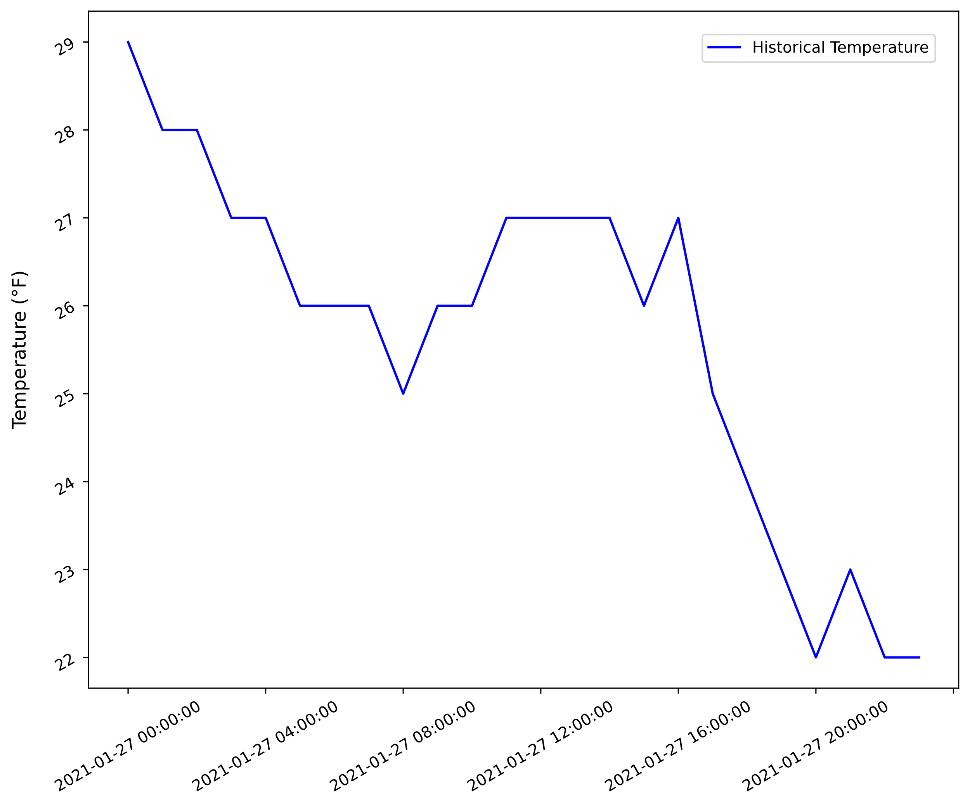
ARIMA Temperature Example: Historical Data (Slide 2 of 2)

Slide 25

ARIMA Temperature Example: Forecasted Data (Slide 1 of 2)
statsmodels' ARIMA() method can forecast data.
Argument order = (3, 1, 1)
$p=3$
$d=1$
$q=1$
predict() method can forecast based on start/end times:
Time | Predicted Temperature
2021-01-28 00:00:00 | 21.615124
2021-01-28 01:00:00 | 21.281705
2021-01-28 02:00:00 | 21.389586
2021-01-28 03:00:00 | 20.921223
2021-01-28 04:00:00 | 21.124714
2021-01-28 05:00:00 | 20.840282

Slide 26
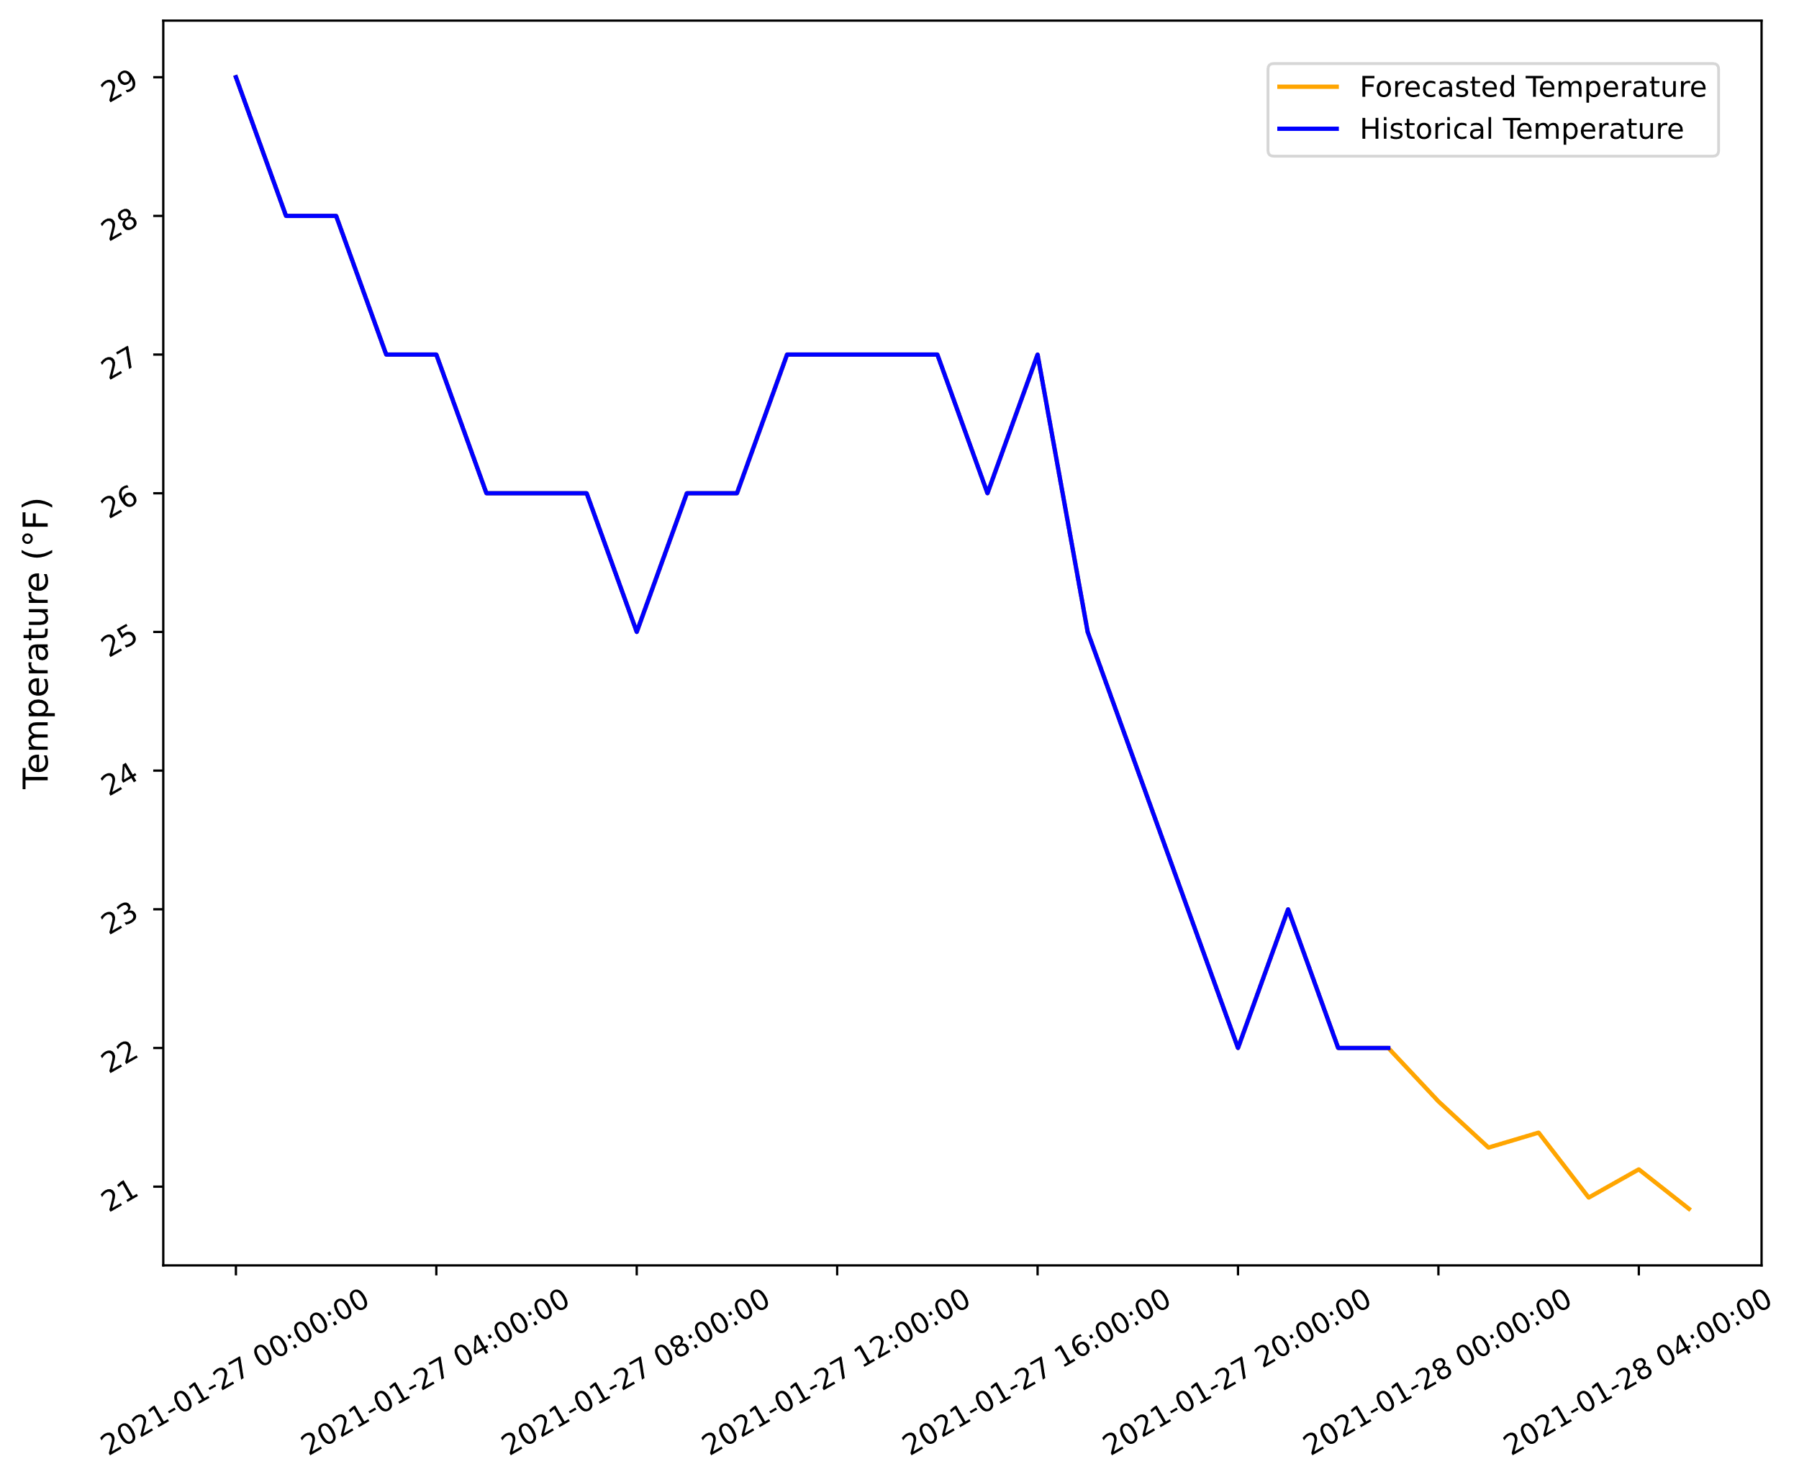
ARIMA Temperature Example: Forecasted Data (Slide 2 of 2)

Slide 27
Guidelines for Training Forecasting Models
Consider splitting your data into 60% training and 40% testing data.
Split time series data into segments instead of selecting values at random, with training data always earlier than test data.
Reduce training time by using fewer categories or applying dimensionality reduction.
Consider using differences rather than raw values when forecasting time series data.
Use multiple regions for testing time series data to evaluate overfitting of data.

Slide 28
Cost Function
Cost function: A function that attempts to quantify the error between the estimated values and the actual labeled training values.
A way to evaluate the performance of a model on training data.
Evaluates how poorly the model estimates—in other words, its cost.
Determines how bad model is at estimating relationship between dependent and independent variables.
The learning process involves minimizing this cost function.
Leads model toward optimal parameters.
Normal equation is one way of minimizing cost function.
Tuning techniques try to minimize cost function.

Slide 29
Regularization
900
Unregularized model
Regularized model
Sale Price ($)
200
0
120
Months Since Release

Slide 30
Regularization Techniques
Technique | Description
Ridge | Minimizes ℓ₂ norm (sum of square coefficients). Keeps parameter weights small. Suitable for datasets with many features, each with estimative power.
Lasso | Minimizes ℓ₁ norm (forces coefficients of least relevant features to 0). Suitable for datasets with small to moderate number of features with moderate estimative power. Eliminates features with no significant effect.
Elastic net | Weighted average of both ridge and lasso. α determines which norm has more influence (ridge: closer to 0; lasso: closer to 1). Suitable for datasets with small to moderate number of relevant features. Usually preferable to lasso. Ridge may still be better if you can't afford to lose any features.

Slide 31

Gradient Descent
Start value
Cost
$\hat{θ}$ (Minimum)
Model Parameters

Slide 32
Small Learning Rate
Start value
Cost
Model Parameters

Slide 33
Large Learning Rate
Cost
Start value
Model Parameters

Slide 34
Grid/Randomized Search for Regression
You can use hyperparameter searching for regression in addition to classification.
Same basic mechanics:
Define parameter grid/distribution to search.
Select evaluation metric to optimize.
Run search.
You need to be aware of the available hyperparameters for your model.
Some have unique parameters, like decision trees.
Example:
grid = [{'penalty': ['l1', 'l2'],
'alpha': [0.0001, 0.001, 0.01, 0.1],
'learning_rate': ['constant'],
'eta0': [0.01, 0.05, 0.1]}]
search = GridSearchCV(model, param_grid = grid,
scoring = 'mean_squared_error', cv = 5)

Slide 35
Guidelines for Tuning Regression Models
Use lower-order polynomials for linear regression to avoid overfitting.
Increase leaf size/tree size in tree-based regression models if overfitting is occurring.
Tune the number of trees in a forest as well as leaf size, measuring overfitting with each change.
Keep in mind that increasing leaf size for a decision tree can lead to diminished skill.
Apply grid and/or randomized searches to evaluate a model across a range of hyperparameter values.

Slide 36
Tuning Regression Models

Slide 37
Evaluate Regression Models

Slide 38
Cost Functions Used to Evaluate Regression Models
Cost functions used to evaluate regression models:
Mean squared error (MSE)
Mean absolute error (MAE)
Coefficient of determination (R²)
Each outputs a score that can guide tuning.
No objectively good score.
Dependent on nature of data.
Use cost scores to compare, not to determine absolute performance.

Slide 39

Mean Squared Error (MSE)
Mean squared error is used as a simple and effective cost function for regression, where:
n is the size of the training set, i.e., the total number of examples.
y_{i} is the actual value of a variable.
ŷ_{i} is the estimated value of the variable.
J(θ) is the cost function itself.
$$J(θ)=\frac{1}{n}\sum_{i=1}^{n}{{\left(y_{i}−{\hat{y}}_{i}\right)}^{2}}$$
Usually simplest and most effective cost function for regression.
Error is calculated, then squared, then average is taken.
Squaring makes all values positive; otherwise, average trends toward 0.
RMSE takes square root of MSE to make results more interpretable.
Puts score in same scale as label being estimated.
Similar to how standard deviation makes variance more interpretable.

Slide 40

Mean Absolute Error (MAE)
Mean absolute error is an alternative cost function, where:
n is the size of the training set, i.e., the total number of examples.
y_{i} is the actual value of a variable.
ŷ_{i} is the predicted value of the variable.
J(θ) is the cost function itself.
Doesn't consider sign of values.
Unlike MSE, MAE doesn't:
Minimize errors much less than 1.
Exaggerate errors much greater than 1.
However, MSE is preferred because:
It is differentiable.
It matches what the linear equation is minimizing.
$$J(θ)=\frac{1}{n}\sum_{i=1}^{n}{\left|y_{i}−{\hat{y}}_{i}\right|}$$

Slide 41
Coefficient of Determination
Coefficient of determination: A statistical measure indicating how much of a dependent variable's variance is explainable by the model.
Also called R².
Used as scoring method for regression models.
Usually between 0 and 1.
Perfectly hitting all points on the line would be a 1.
As line fails to pass through more and more points, R² decreases toward 0.
Decreasing R² is less and less able to explain variance.
R² of 0.76 means 76% of variance in label is explainable by the model.
Can be negative if model performs worse than baseline.
Model learns wrong patterns in data.
High R² does not always mean a more skillful model, and vice versa.
Low R² may have more estimative power than high R².
R² can change dramatically from model to model, but estimation error may stay the same.
Strong connection between variable does not always imply strong causality.
Minimizing MSE is preferable to optimizing R².

Slide 42
Guidelines for Evaluating Regression Models
Consider regression models are evaluated based on cost.
Prefer MSE over R² when evaluating regression model skill.
Prefer MSE over MAE.
Consider using root MSE to make results more interpretable.
Consider using relative error to compare models on different scales.

Slide 43
Evaluating Regression Models

Slide 44
What type of data in your organization do you think might be conducive to regression analysis?
What types of evaluation metrics do you think you'll find most useful when tuning a regression model?

